Slide 1
RFM CUSTOMER SEGMENTATION
For period: 2010-12-01 to 2011-12-01

Slide 2
OVERVIEW
4334 customers
8M Revenue
$370 per purchase
5 purchases per year
31 % active ones
6.5M from active ones
$430 from active ones
11 from active ones
Active customers: customers under Best, Loyal, Big Spenders segment

Slide 3
CUSTOMER SEGMENT CRITERIA
1 | BEST | Bought > 5 times AND spent > $1550 this year
2 | LOYAL | Bought > 5 times this year
3 | BIG SPENDER | Spent > $1550 this year
4 | LOST | Spent < $1550 AND bought < 5 times this year

Slide 4
RFM VARIABLES
RECENCY | FREQUENCY | MONETARY
# of days from the last purchase till 2011-12-01 | # of purchases during 2010-12-01 to 2011-12-01 | Sum of purchases during 2010-12-01 to 2011-12-01
Per customer | Per customer | Per customer

Slide 5
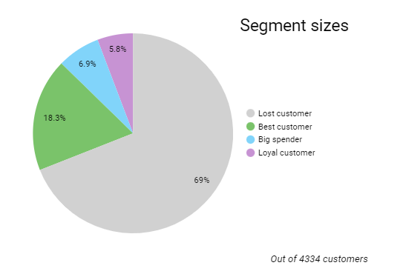
SIZE OF EACH SEGMENT
- Lost customer segment is the biggest
DOES IT CAUSE AN ISSUE?

Slide 6
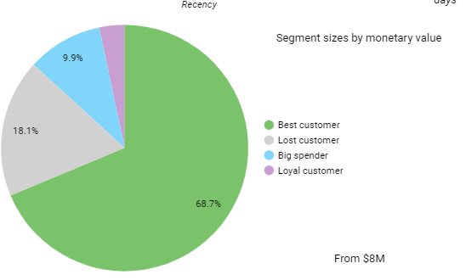
MONETARY VALUE OF EACH SEGMENT
- 18% of generated revenue is from lost customers segment

Slide 7
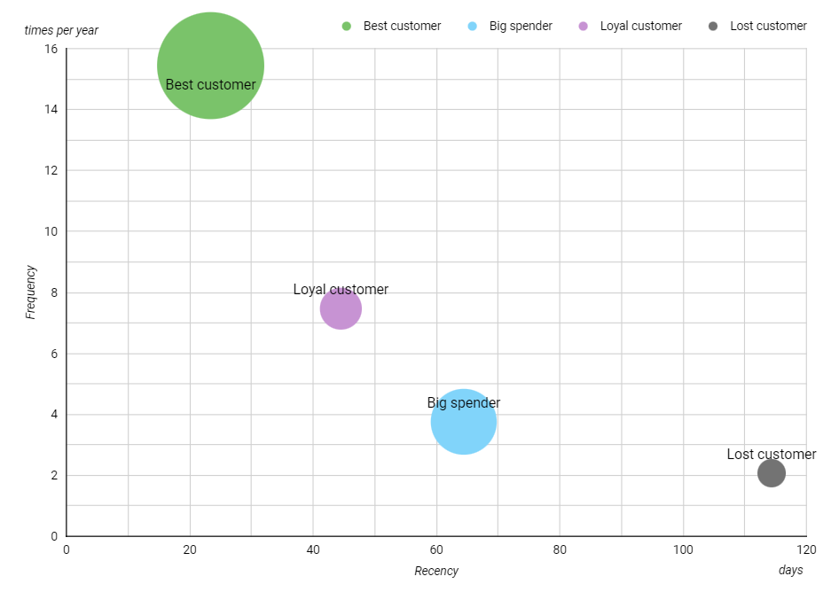
PERFORMANCE PER SEGMENT
BEST
Recency avg.: 23 days
Frequency avg.: 15 times per year
Monetary avg.: $7 000 per year
*Bubble size corresponds to avg. monetary value per customer
LOYAL
Recency avg.: 44 days
Frequency avg.: 7 times per year
Monetary avg.: $1 000 per year
BIG SPENDER
Recency avg.: 64 days
Frequency avg.: 4 times per year
Monetary avg.: $2 500 per year
LOST
Recency avg.: 100 days
Frequency avg.: 2 times per year
Monetary avg.: $500 per year

Slide 8
MOST POPULAR PRODUCTS PER SEGMENT
BEST | LOYAL | BIG SPENDERS | LOST
WHITE HANGING HEART T-LIGHT HOLDER | WHITE HANGING HEART T-LIGHT HOLDER | REGENCY CAKESTAND 3 TIER | WHITE HANGING HEART T-LIGHT HOLDER
JUMBO BAG RED RETROSPOT | REGENCY CAKESTAND 3 TIER | JUMBO BAG RED RETROSPOT | REGENCY CAKESTAND 3 TIER
REGENCY CAKESTAND 3 TIER | HEART OF WICKER SMALL | WHITE HANGING HEART T-LIGHT HOLDER | ASSORTED COLOUR BIRD ORNAMENT

Slide 9
SUMMARY & RECOMMENDATIONS
01 | 31% of customers are active. They increase KPIs. | Focus on converting lost customers to active.
02 | Majority of clients (69%) fall under lost customer segment. 18% of revenue comes from this segment | Analyse what makes customers churn out competitors/product quality or price/poor ads/etc.?
03 | Best customers outperform other segments significantly | Improve customer experience for this segment
04 | Loyal customers buy more frequently then Big Spenders | Reliable income source. Keep them engaged, offer lower price products.
05 | Big Spenders do not buy as frequently but spend more than twice as Loyal customers | Offer higher value products. Increase engagement by new offers, product lines.
06 | Most successful products among all segments are WHITE HANGING HEART T-LIGHT HOLDER and REGENCY CAKESTAND 3 TIER | Invest in these products more. Mention them in ad campaigns

